Slide 1
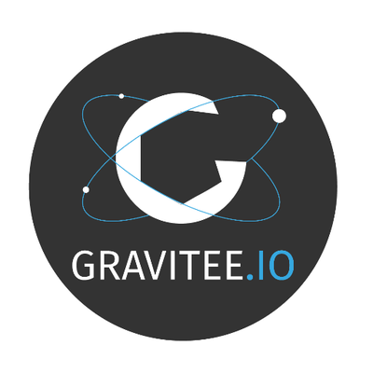
Gravitee – API Management
API Management Made Simple

Slide 2
Gravitee
API management platform that provides a comprehensive solution for designing, deploying, and managing APIs.
features
benefits
use cases
brief demo

Slide 3
Agenda
Introduction to API Management
What is Gravitee?
Core Features of Gravitee
Benefits of Using Gravitee
Use Cases
Demo

Slide 4
Introduction to API Management
Definition:
API Management involves the process of designing, deploying, and managing APIs in a secure and scalable environment.
Importance:
Facilitates integration, improves security, enhances performance, and ensures API availability.

Slide 5
What is Gravitee?
Overview: Gravitee is an open-source API management platform that provides a full suite of tools for API design, security, and monitoring.
History and Background: Brief history of Gravitee and its evolution in the API management space.

Slide 6
Core Features of Gravitee
API Gateway: Manage and route API traffic efficiently.
API Designer: Visually design APIs with a user-friendly interface.
Access Management: Implement robust authentication and authorization mechanisms.
Analytics and Monitoring: Track API performance and usage metrics.
Policy Management: Define and enforce policies for API traffic.

Slide 7
Benefits of Using Gravitee
Scalability: Handles high traffic volumes with ease.
Security: Comprehensive security features to protect APIs.
Flexibility: Supports multiple API protocols and customization.
Open-Source: Cost-effective and community-supported.
User-Friendly: Intuitive interface for developers and administrators.

Slide 8
Use Cases
Enterprise Integration: Facilitating internal and external system integrations.
Microservices Architecture: Managing microservices interactions and communication.
Digital Transformation: Enabling businesses to adopt digital strategies through effective API management.
Developer Portals: Providing a platform for developers to access and use APIs.

Slide 9
Demo
Live Demonstration: Show how to create, deploy, and manage an API using Gravitee.
API Creation: Step-by-step walkthrough.
Policy Implementation: Apply security and traffic management policies.
Analytics Dashboard: View usage metrics and performance data.

Slide 10
Summary: Recap the key points covered in the presentation.
Call to Action: Encourage the audience to explore Gravitee further, try a demo, or reach out for more information.

